Slide 1
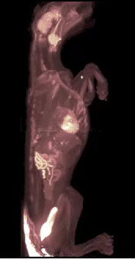
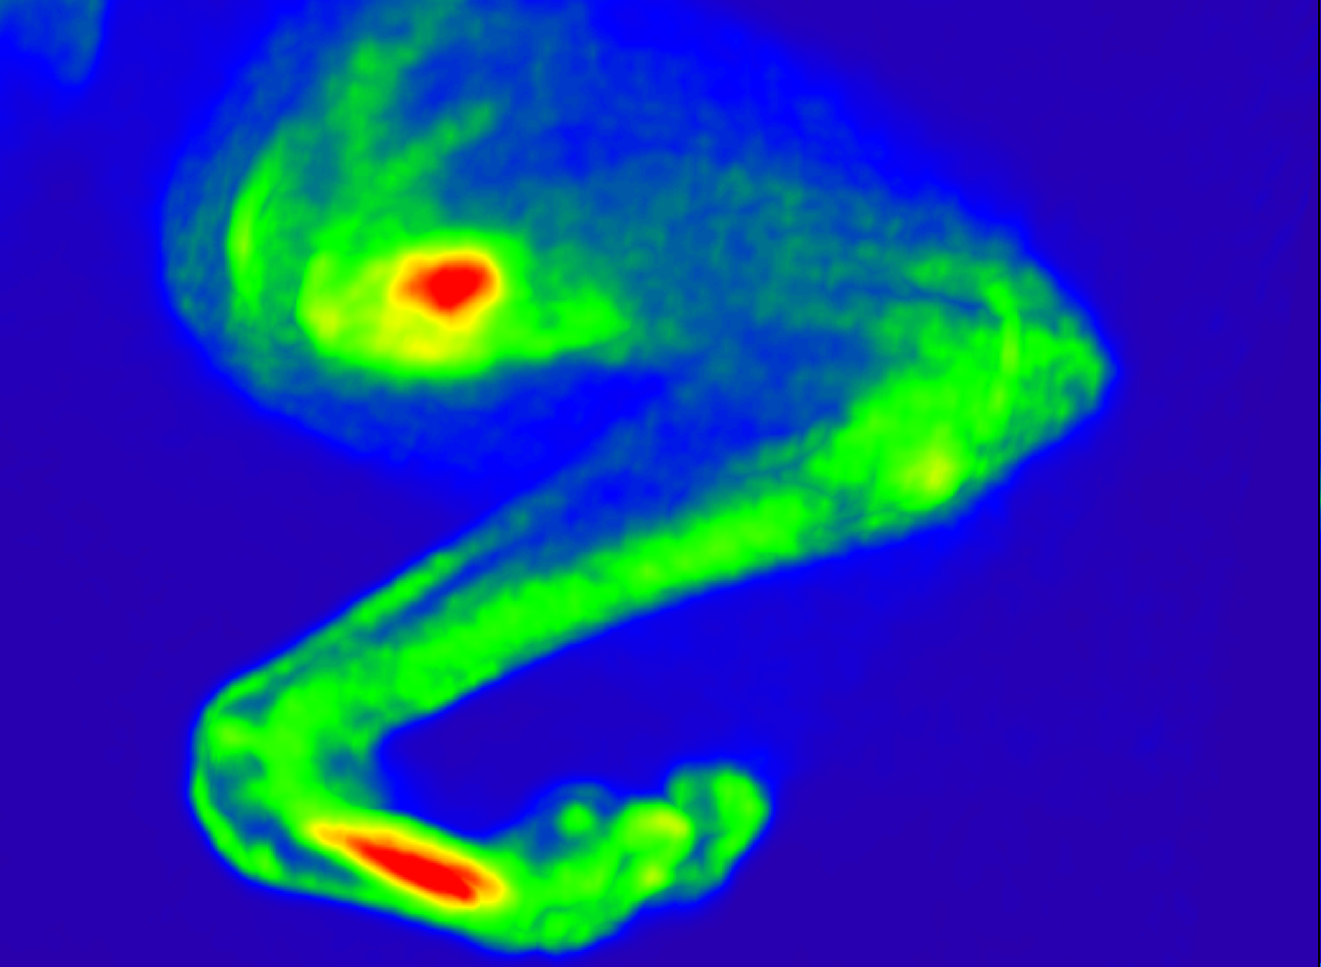
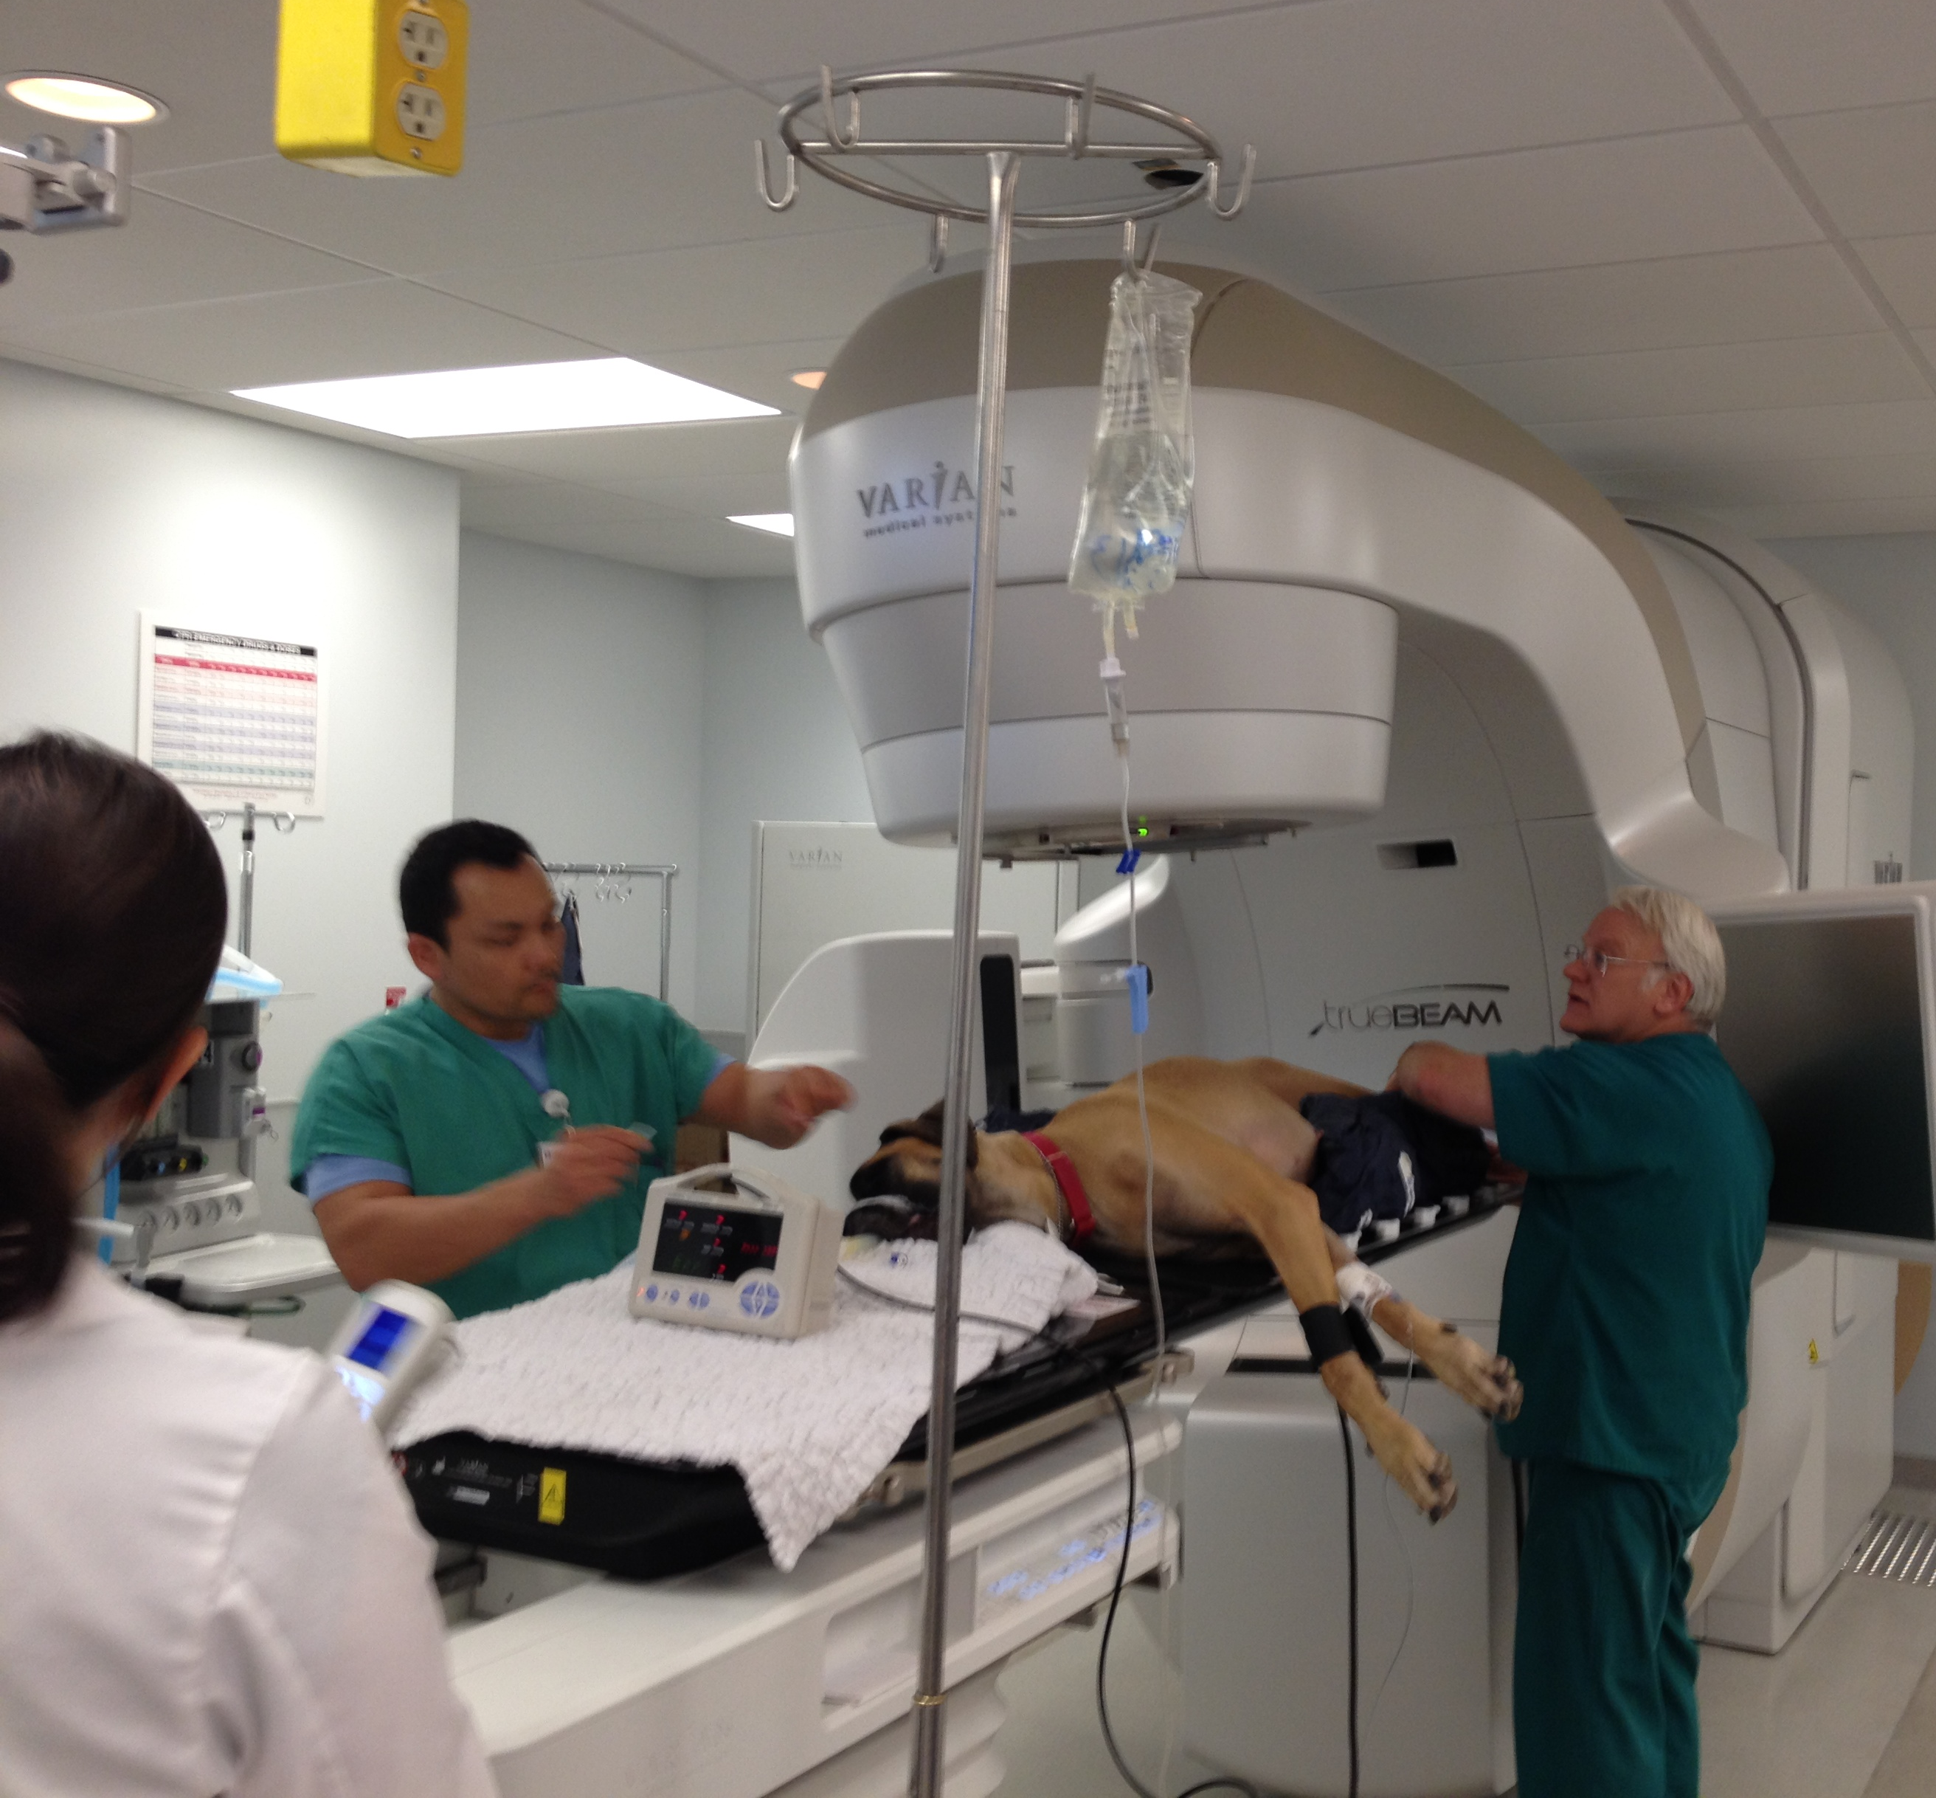
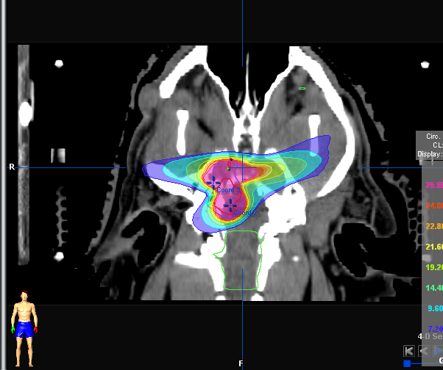
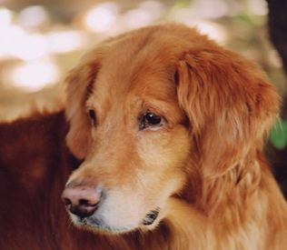
The Dog as a Model of Human Cancer
Michael S. Kent, MAS, DVM, DACVIM, DACVR
Professor Radiation Oncology
Co-Program Leader Comparative Oncology Program – UCDMC NCI Designated Comprehensive Cancer Center
UC Davis

Slide 2
Similarities between species
We do not only look alike
Live in same domestic environment
Developed together over the last 10,000 – 15,000 years
Receive preventative and health care

Slide 3
Dog in US society
70-80, 000, 000 dogs in the United States
~37% of US households have at least one dog
63.2% of households consider their dog a family member
Many dogs now living to middle and geriatric age
AVMA 2012 Pet Ownership and Demographics Sourcebook

Slide 4
Dogs as a model
Inbreeding has led to many breed predilection of disease
  Many of these seen in humans
  Allows smaller number of individuals to identify
    Less background noise
Many dogs are geriatric allowing for natural development of disease of aging – such as cancer
  ~45% of dogs >6 years in the US

Slide 5
Comparative medicine
After humans most diverse and known disease occurrence
~400 inherited disease in dogs where human counterparts have been identified
Affected by many of the same infectious diseases
Affected by similar cancers

Slide 6
The dog as a model?
Important to distinguish between laboratory animals and pets
Toxicity testing in a “Large Animal” model
Very different than dogs with spontaneous disease

Slide 7
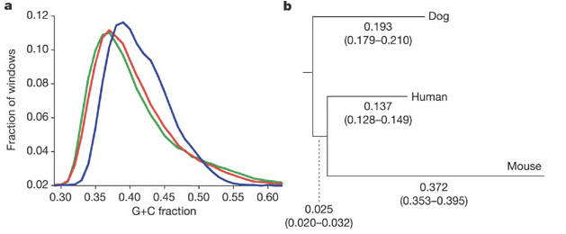
Its in the DNA
650 Mb of shared ancestral DNA with humans
Have closer DNA and protein sequences with humans than mice
Lindblad-Toh, K. et al. (2005) Genome sequence, comparative analysis
and haplotype structure of the domestic dog. Nature 438, 803–819

Slide 8
Dogs informing human disease
Genetic studies

Slide 9
Cancer types similar between species
Lymphomas (NHL) and Leukemias
Multiple Myeloma
Soft Tissue Sarcoma
Osteosarcoma (up to 75 x more common than in humans)
Some forms of mammary cancer
Melanoma
Brain tumors (meningioma, glial)
Bladder tumors

Slide 10
What is missing in mouse models?
Long latency periods
Genomic instability
Tumor heterogeneity
Microenvironment heterogeneity
Metastatic patterns
Often young mice used
Often lean mice used
Often immunocompromised mice used
Differences in the immune system

Slide 11
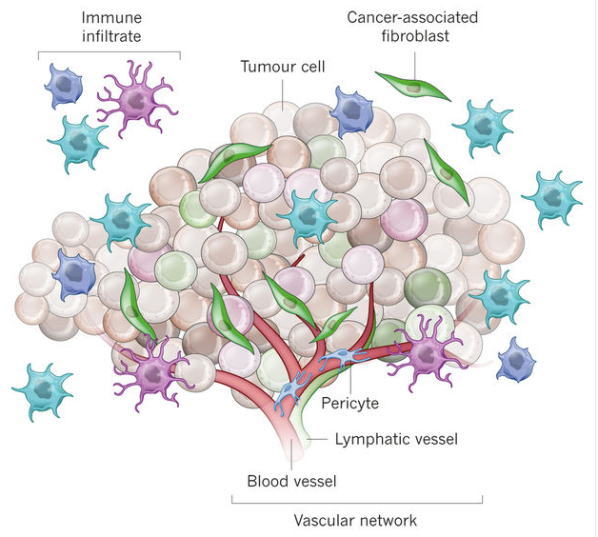
Tumor microenvironment
Tumor cells
Stromal cells
Immune cells
Vasculature
Junttila MR, de Sauvage FJ. Influence of tumour micro-environment heterogeneity on therapeutic response. Nature. 2013 Sep 19;501(7467)
Notes:
Tumour formation involves the co-evolution of neoplastic cells together with extracellular matrix and vascular endothelial, stromal and immune cells. The tumour niche is a dynamic physical topography in which structural support, access to growth factors, vascular supply and immune cell interactions can vary drastically even within the same lesion. The immune infiltrate can include multiple cell types, these cell populations can have both pro- and anti-tumour functions and can vary in their activation status and their localization within the tumour. The vascular network can differ in regard to the vessel's tissue of origin, maturity (extent of pericyte coverage), interstitial pressure and functionality. Cancer-associated fibroblasts can have significant plasticity and diverge with regard to activation status, localization within the tissue, stress response and origin.

Slide 12
Immune system similarities to human
Canine immune system is genetically and developmentally much more similar to humans than rodent models
  Eg. TLR8 non functional in rodent
    Unlike humans and dogs
Tumors develop in spontaneous dog model in the face of intact immune system
  Chronic inflammation
Complexity of tumor immunity and suppression replicated
  CD8+ T cells, Tregs, NK cells, APCs, Dendritic cells etc

Slide 13
Advantages of dog models
Spontaneous tumor development
Similar tumor microenvironment
Intact immune systems
More similar toxicity profiles
Larger size
  Immunotherapy Trials
  Development of medical procedures
  Radiotherapy Trials
  New Device and Drug Delivery Trials

Slide 14
Administrative Supplements for P30 Grant to Support Research in Canine Immunotherapy
Collaboration of NCI-Designated Cancer Centers and Veterinary Medical Colleges. $318,472 Direct Costs; 13 investigators combining several programs
Genomic Analysis of Canine High Grade Gliomas, Melanomas, and Osteosarcomas
  Whole exome sequencing for analysis of non-synonymous somatic mutational load and RNAseq expression analysis for mutational load and DLA typing. 30 banked and 5 new samples.
Immunophenotyping and Analysis of TME

Slide 15
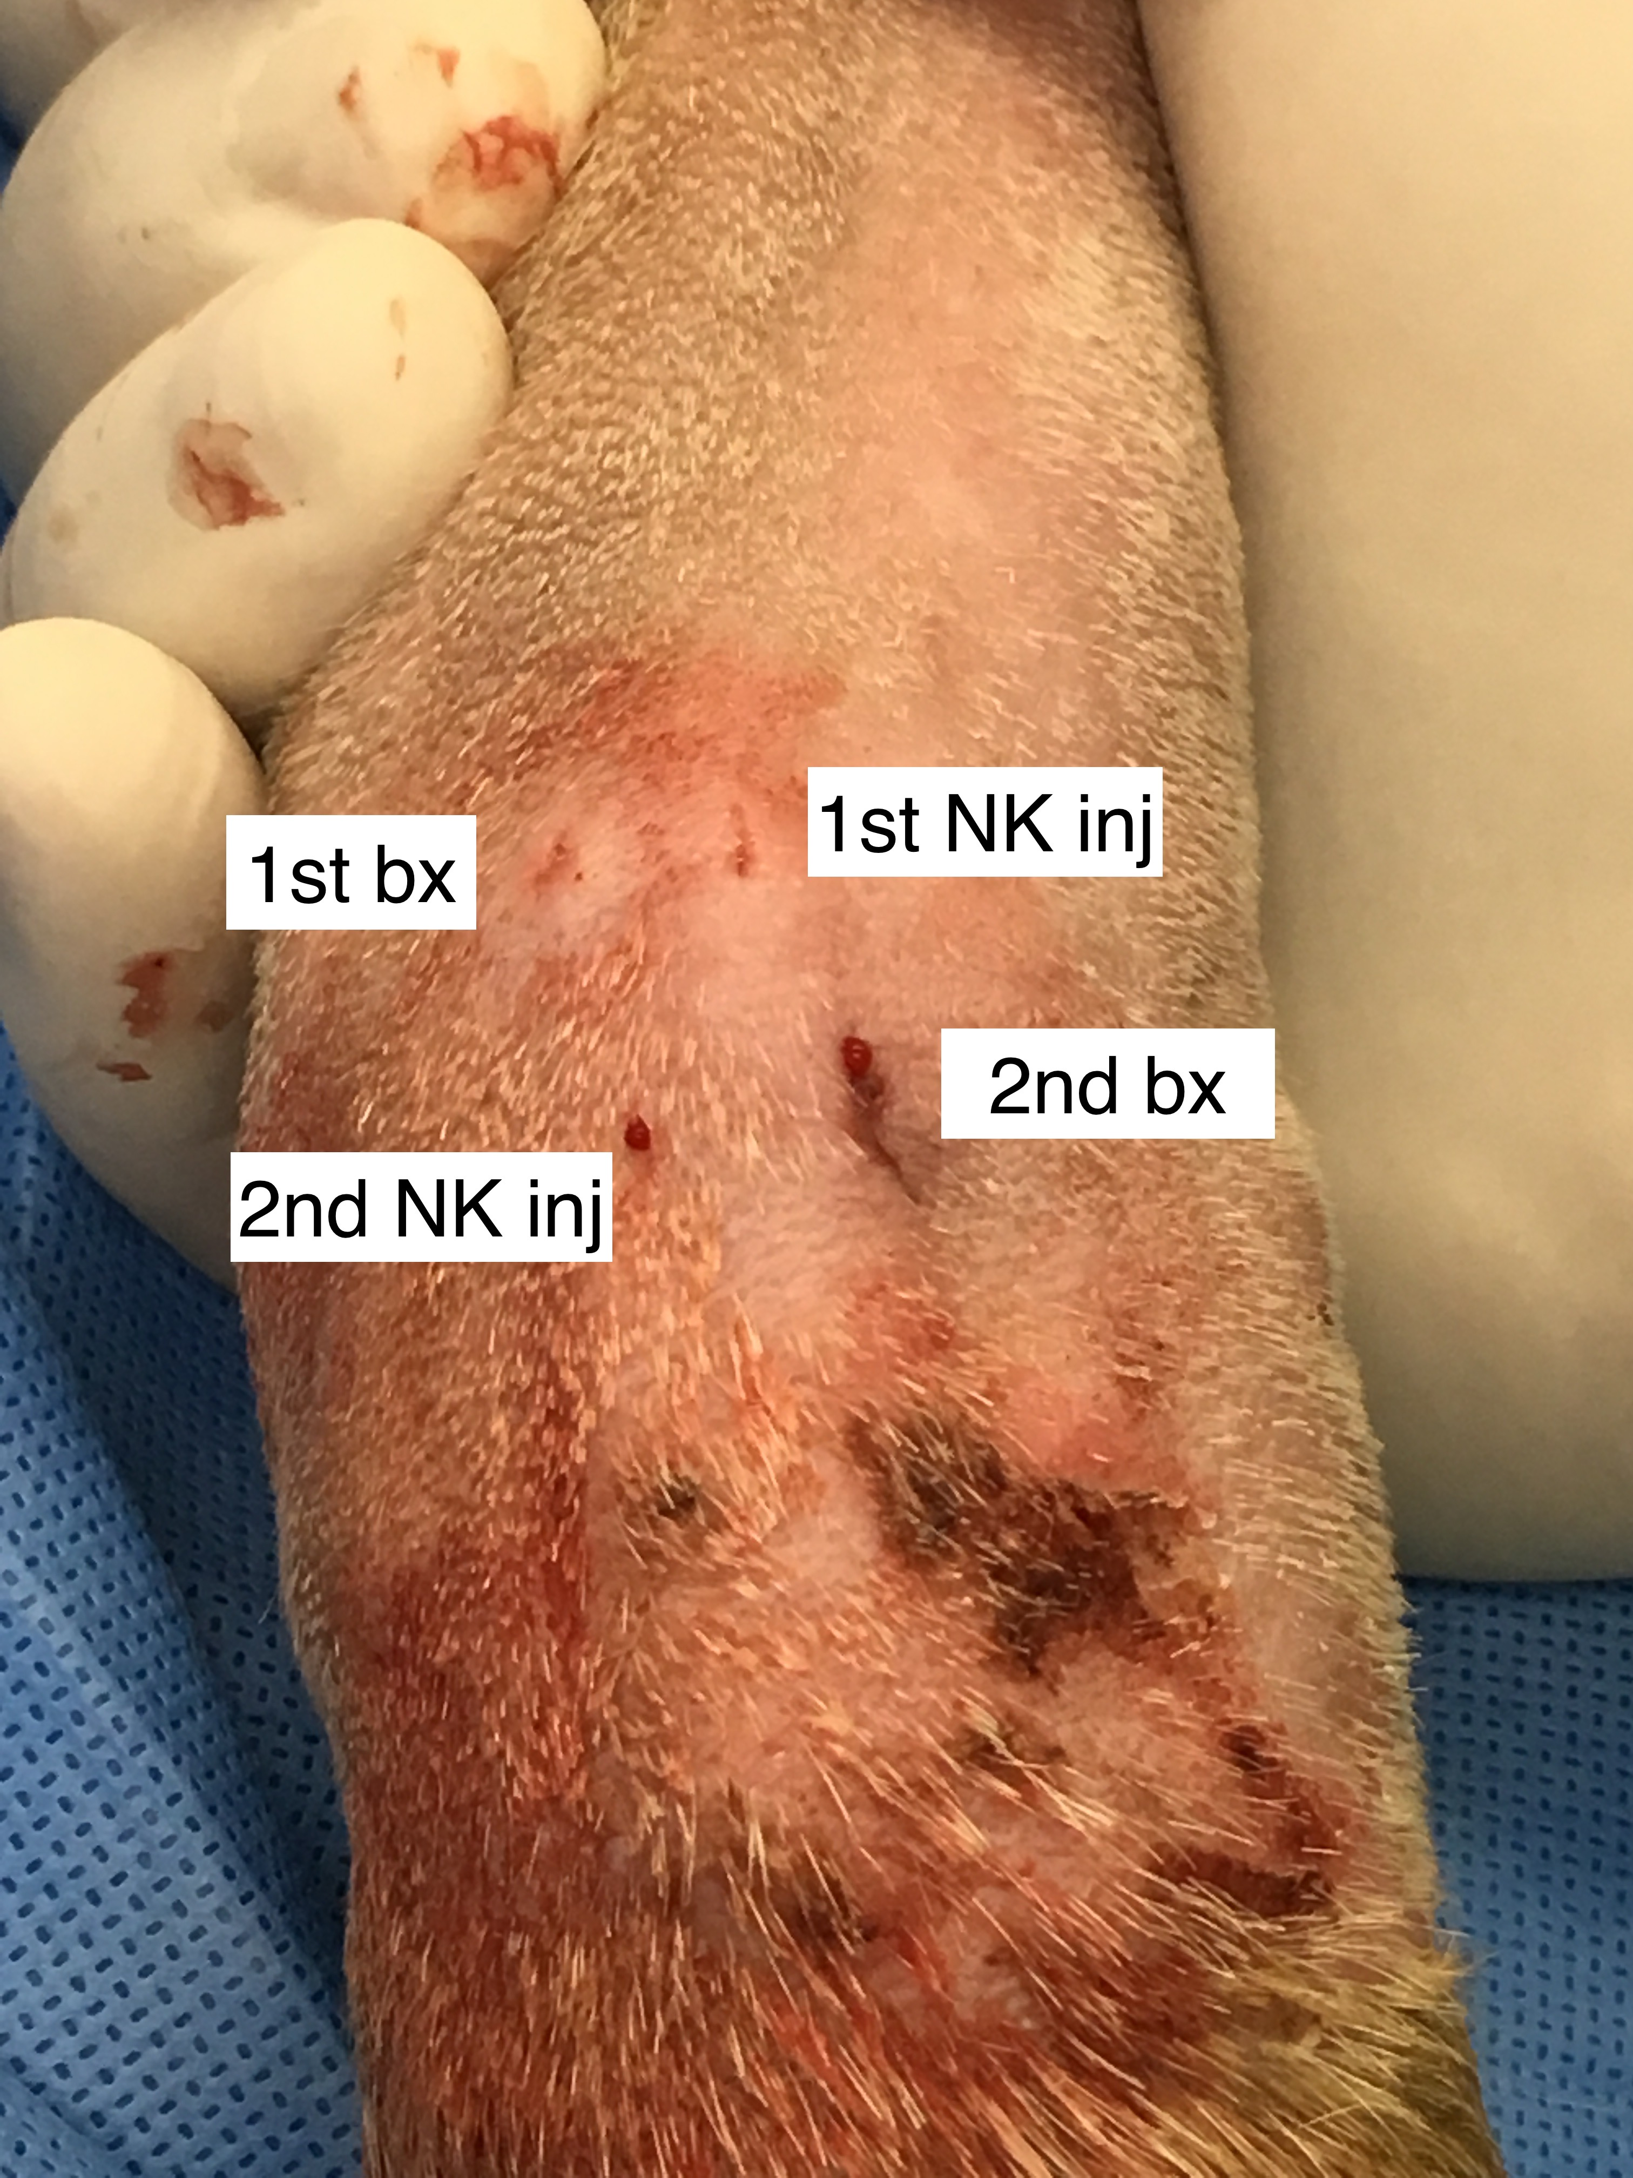
Radiotherapy enhances natural killer cell cytotoxicity and localization in pre-clinical canine sarcomas and first-in-dog clinical trial
Isolated and expanded dog NK cells
Post RT NK cytotoxicity increases
NK cells cytotoxic ex-vivo and delayed tumor growth in a PDX model
Dog clinical trial – 10 dogs
Increase in Granzyme B+ CD45+ PBMCs
NK cells persist in MTE post injection
NK Transfer x 2
(2 weeks)
Observe
(3 months)
Observe
(3 months)
Weekly RT (9 Gy) x 4 weeks
Enroll
RT
RT
RT
RT
NK
NK
Path
CT
Path
CT
Path
CT
Path
CT
PBMCs
PBMCs
Treatment schema for combined RT/NK immunotherapy targeting CSCs and non-CSCs in canines with locally advanced osteosarcoma.
Collaborations: Murphy, Canter, Kent, Sparger, Culp (Intra)

Slide 16
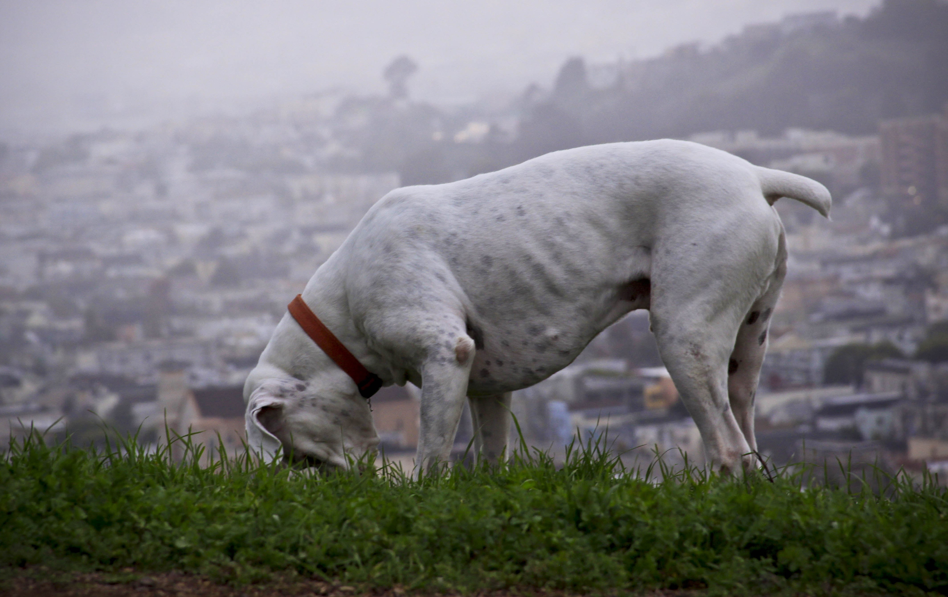
Thank you

